Slide 1
Negative pressure hydrocephalus.
The role of CSF leaks
Aristotelis S. Filippidis
M. Yashar S. Kalani
Harold L. Rekate
Pediatric Neurosurgery, Division of Neurosurgery, Barrow Neurological Institute
St. Joseph’s Hospital and Medical Center, Phoenix, Arizona, USA

Slide 2
Case presentation
HPI: A 61 yo patient presented,
lethargic and dragging his left foot in the emergency room.
Symptoms of hydrocephalus were present.
PMH: clipped ruptured PICA aneurysm complicated by post-hemorrhagic hydrocephalus, meningitis and a CSF leak.
The patient needed multiple shunts revisions that failed repeatedly in the past.

Slide 3
Steps in Treatment
IMAGING ventriculomegaly demonstrated on CT was present at the time and we thought that the patient had hydrocephalus due to a failed a shunt.
SHUNT REVISION
But the patient did NOT IMPROVE.
WHY ???

Slide 4
WHy this SHUNT FAILS ?

Slide 5
GATHERED EVIDENCE
NO proof of proximal or distal obstruction of the shunt
NO proof of mechanical shunt malfunction
Negative pressure measured at the ventricular level
Radionuclide studies and iohexol cisternogram demonstrated a block between the ventricular level and subarachnoid space (SAS)

Slide 6
IS this
negative pressure hydrocephalus ?

Slide 7
NEGATIVE pressure HYDROCEPHALUS
DEFINITION
Ventriculomegaly
Verified Negative pressure measurement with ICP probe
At the ventricular compartment
Signs and symptoms of hydrocephalus
THE USUAL CONTEXT:
Posthemorrhagic or postinfection hydrocephalus
Disconnection between subarachnoid space (SAS) and ventricular compartment
Presence of a cerebrospinal (CSF) leak
Presence of a failing shunt

Slide 8
SO WHAT’S WRONG?
A LEAK at the subarachnoid space lowering the pressure in this CSF compartment
A BLOCKAGE at the connection between the ventricles and the subarachnoid space (remember hemorrhage in SAS and meningitis in patient’s PMH)
A MODIFICATION of the brain’s ability to resist distortion due to applied forces (modified brain turgor)
A GRADIENT in the transmantle pressure (pressure at the brain surface) is created, the subarachnoid space acts as a VACUUM, the ventricles expand and the shunt is not working due VENT_{pressure} well below threshold
A NEW EQUILIBRIUM is established.

Slide 9
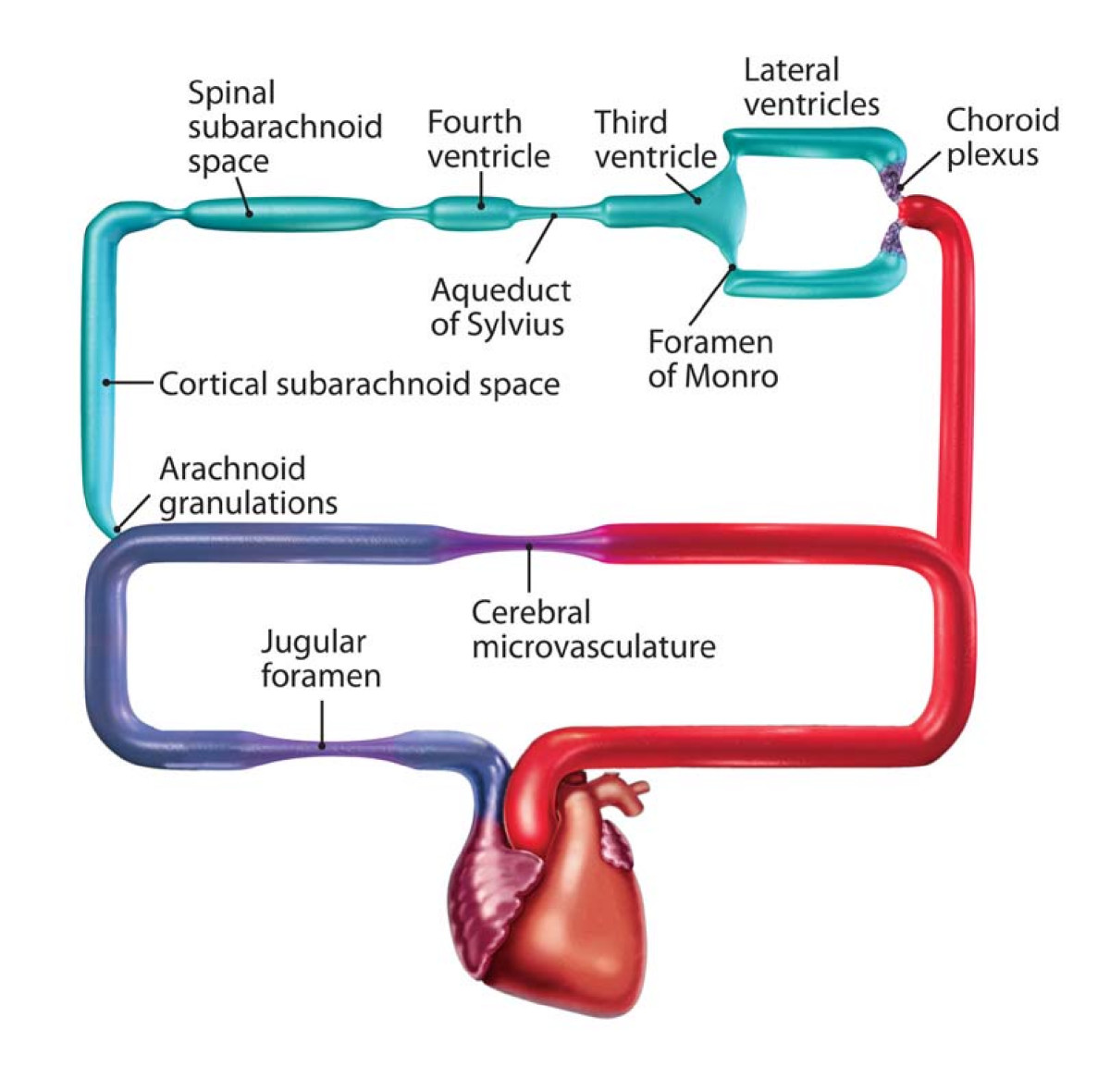
SO WHAT’S WRONG?

Slide 10
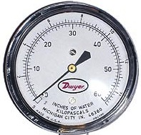
SO WHAT’S WRONG?
Transmantle pressure = P_{VENTS} – P_{SAS} > 0
INITIAL EQUILIBRIUM
cause P_{VENTS} > P_{SAS}
Transit
BRAIN
Vents
SAS
LEAK

Slide 11
SO WHAT’S WRONG?
Transmantle pressure = P_{VENTS} – P_{SAS} = 0
NEW EQUILIBRIUM ESTABLISHED
Stable rate of CSF production and loss
Vents bigger
SAS smaller
Transmantle pressure ZERO

Slide 12
HOW to TREAT ?
SEAL the CSF Leak
Establish Ventricular-Subarachnoid space COMMUNICATION
INCREASE the pressure in SAS
RESTORE modified brain turgor
Reoperation with a watertight closure
Lysis of fibrosis in SAS or ETV in select cases
Neck wrapping as a conservative treatment
EVDs for few days set to subzero pressure

Slide 13
NECK WRAPPING
Compression of the jugular veins
Increases pressure in jugular system
Increases pressure in Superior Sagittal Sinus
CSF absorption from the arachnoid granulations decreases so the pressure in the SAS increases.
Increases brain turgor. Makes brain stiffer.
Ventriculomegaly and HCP symptoms REVERSE transiently!
a. WITHOUT neck wrapping, b. WITH neck wrapping, c. Neck wrapping REMOVED

Slide 14
RESTORING BRAIN TURGOR
So what is BRAIN TURGOR ?
It is the ability of the brain to RESIST DISTORSION
Brain turgor = 0 means a soft brain that can’t resist distorsion, so changes in intracranial volume DO NOT increase ICP, brain distorts and acts like a sponge
Brain turgor = 1 means a stiff brain, highly resistant to distorsion, so changes in intracranial volume DO increase ICP, brain cannot act like a sponge
In Negative pressure HCP the brain turgor is LOW due to loss of venous blood or extracellular fluid

Slide 15
RESTORING BRAIN TURGOR
Prolonged EVDs to subzero ICP restore the ability of the brain to find its previous form. Brain recoils to its previous state but this needs time.
(find opening pressure, lower 2-4cm/d, identify vent shrinkage with CT, maintain the level for few days and then raise EVD till restoration of brain turgor)
Part of the lost Venous blood comes back to brain and restores its brain turgor.

Slide 16
ALGORITHM FOLLOWED

Slide 17
OUTCOME
A ventriculoatrial shunt set at 30mm H₂O was placed
The patient recovered well with resolution of the symptoms of hydrocephalus and ventriculomegaly

Slide 18
Literature
Bannister. A report of eight patients with low pressure hydrocephalus treated by C.S.F. diversion with disappointing results.
Acta neurochirurgica (1972) vol. 27 (1) pp. 11-5
Clarke et al. Very low pressure hydrocephalus. Report of two cases.
J Neurosurg (2006) vol. 105 (3) pp. 475-8
Dias et al. Low-pressure shunt 'malfunction' following lumbar puncture in children with shunted obstructive hydrocephalus.
Pediatric neurosurgery (1999) vol. 30 (3) pp. 146-50
Lesniak et al. Low pressure hydrocephalus and ventriculomegaly: hysteresis, non-linear dynamics, and the benefits of CSF diversion.
Br J Neurosurg (2002) vol. 16 (6) pp. 555-61
McCullough and Fox. Negative intracranial pressure hydrocephalus in adults with shunts and its relationship to the production of subdural hematoma.
J Neurosurg (1974) vol. 40 (3) pp. 372-5
Owler et al. Low pressure hydrocephalus: issues of diagnosis and treatment in five cases.
Br J Neurosurg (2001) vol. 15 (4) pp. 353-9
Pang and Altschuler. Low-pressure hydrocephalic state and viscoelastic alterations in the brain.
Neurosurgery (1994) vol. 35 (4) pp. 643-55; discussion 655-6

Slide 19
Literature
Rekate et al. The importance of the cortical subarachnoid space in understanding hydrocephalus.
Journal of neurosurgery Pediatrics (2008) vol. 2 (1) pp. 1-11
Rekate. The definition and classification of hydrocephalus: a personal recommendation to stimulate debate.
Cerebrospinal fluid research (2008) vol. 5 pp. 2
Rekate. Brain turgor (Kb): intrinsic property of the brain to resist distortion.
Pediatric neurosurgery (1992) vol. 18 (5-6) pp. 257-62
Singounas et al. Observations on the pathogenesis of low pressure hydrocephalus. Analysis of 25 cases.
Neurochirurgia (1976) vol. 19 (1) pp. 22-5
Vassilyadi et al. Negative-pressure hydrocephalus.
J Neurosurg (1995) vol. 83 (3) pp. 486-90

