Slide 1



Pediatric Head Injury:
Part I – Basic Principles
Jogi V. Pattisapu, MD FAAP FACS
Emeritus Medical Director
Arnold Palmer Medical Center
College of Medicine
University of Central Florida
Orlando FL USA
JogiP@mail.UCF.edu

Slide 2
Introduction
Second most common neoplasm
Most common solid malignancy
Derive from intrinsic/parenchymal elements of CNS
Majority are in midline
Classify by site or histology

Slide 3
Introduction
Trauma leading cause of death in children.
More deaths than all other diseases combined!
Often occurs after-hours, requires intense and immediate interventions.

Slide 4
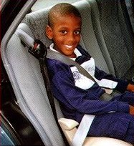
Introduction
500,000 admissions per year
3000 - 4000 deaths per year
20,000 prolonged hospitalization
Decreased M/M in recent decades.
Better understanding of pathophysiology

Slide 5
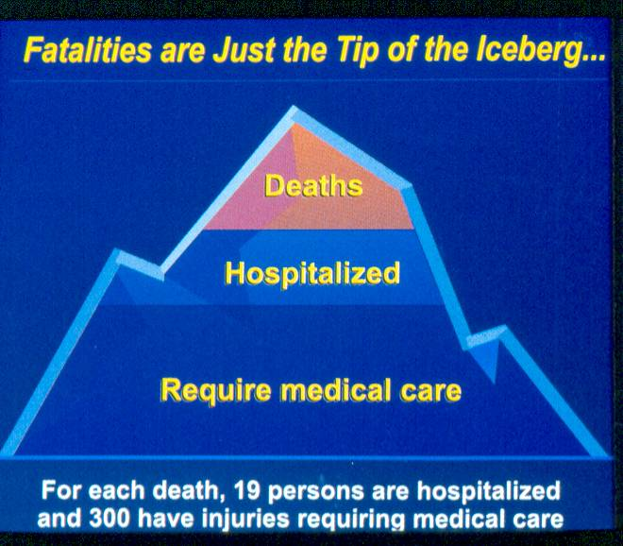
Introduction

Slide 6
Algorithim
Derivation of the children’s head injury algorithm for the prediction of important clinical events decision rule for head injury in children
Dunning J, Daly JP, Lomas J-P, et al on behalf of the children’s head injury algorithm for the prediction of important clinical events (CHALICE) study group
Sensitivity 98%. Scan rate 14%
Arch Dis Child 2006; 91:885-891

Slide 7
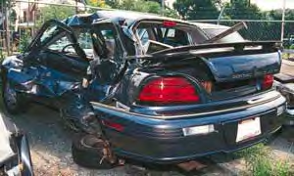
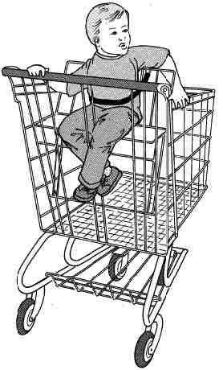
Etiology
Falls < 10 y.o.
MVA > 10 y.o.
NAT < 2 y.o.
Sports > 4 y.o.
50% with associated injuries
GCS correlates with outcomes
80% mild, 10% mod., 10% severe

Slide 8
Pathophysiology
Brain 15% at birth, 3% as adult
Skull / brain relationships vary
Increased water content in children
Diffuse injury more common
Less operative trauma
Plasticity of neurologic return

Slide 9
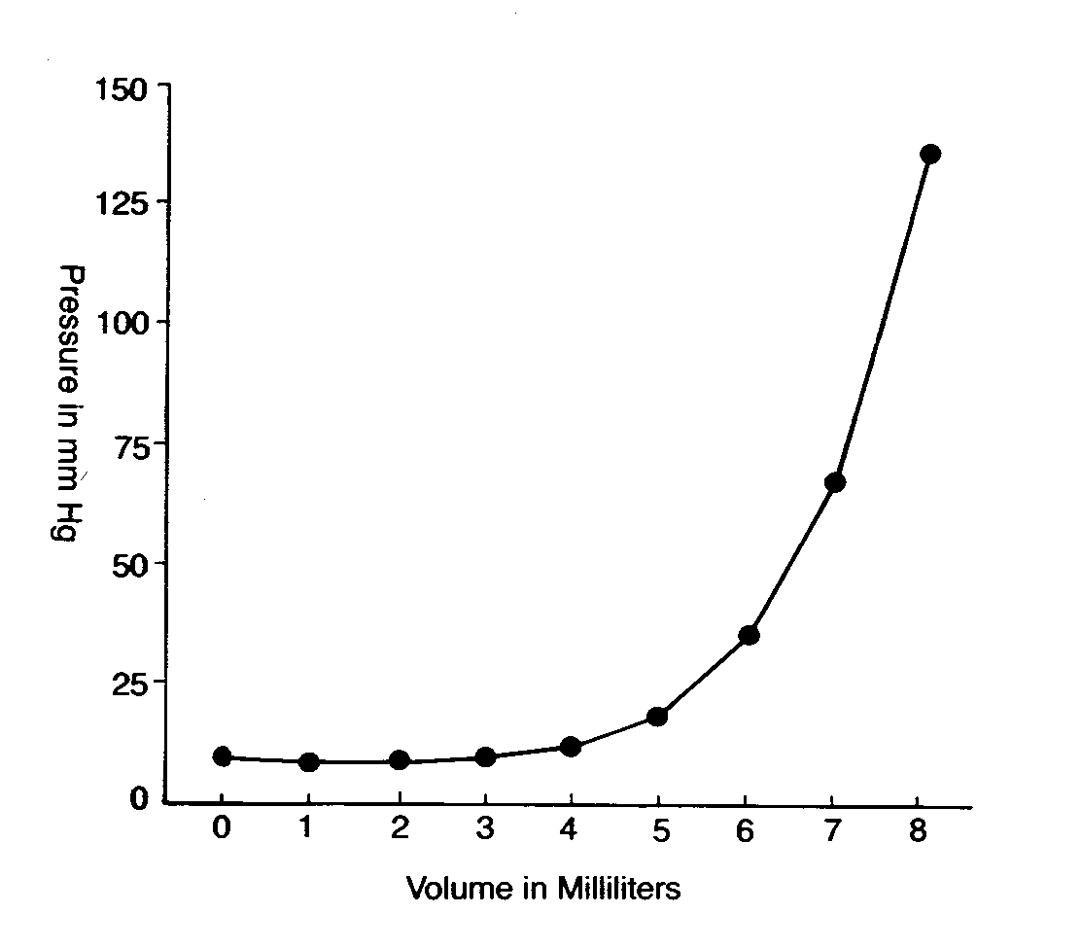
Monro-Kellie Doctrine
V _{blood} + V _{CSF} + V _{brain} = V _{total}
Intracranial space is limited!
Hypothesis proposed in 1783
Cushing popularized concept in 1902
CPP = MAP - ICP
~ 50 mm Hg adequate in children
Ultimate goal = adequate CPP

Slide 10
Cerebral Blood Flow
Adult human brain weighs 1500gm
2% body wt. & receives 15% C.O.
Measured by xenon and TCD
Need continuos O2 & glucose supply
Cerebral edema causes CBF
Increased with loss of autoregulation

Slide 11
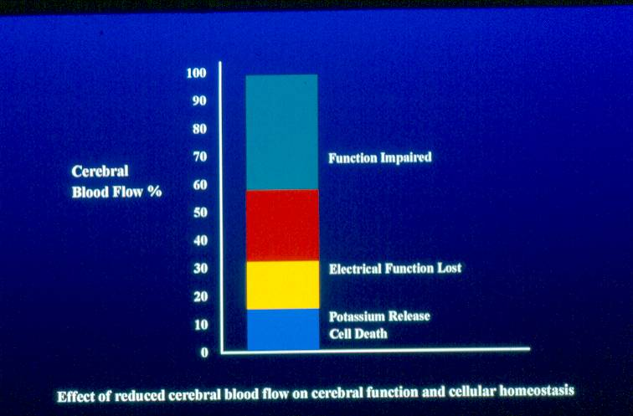
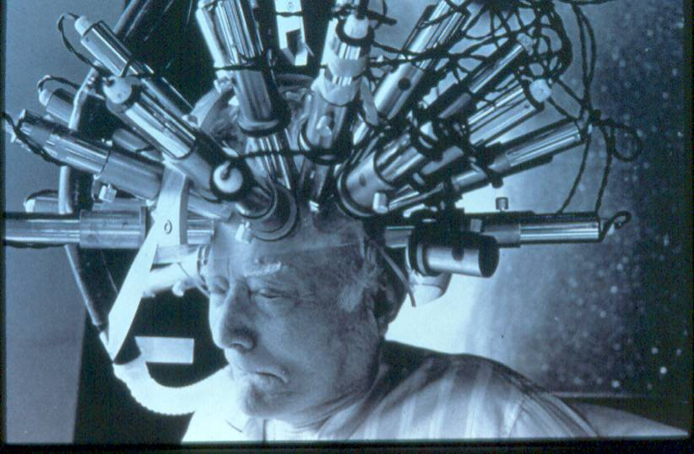
Pediatric
Head
Injury
Cerebral Blood Flow

Slide 12
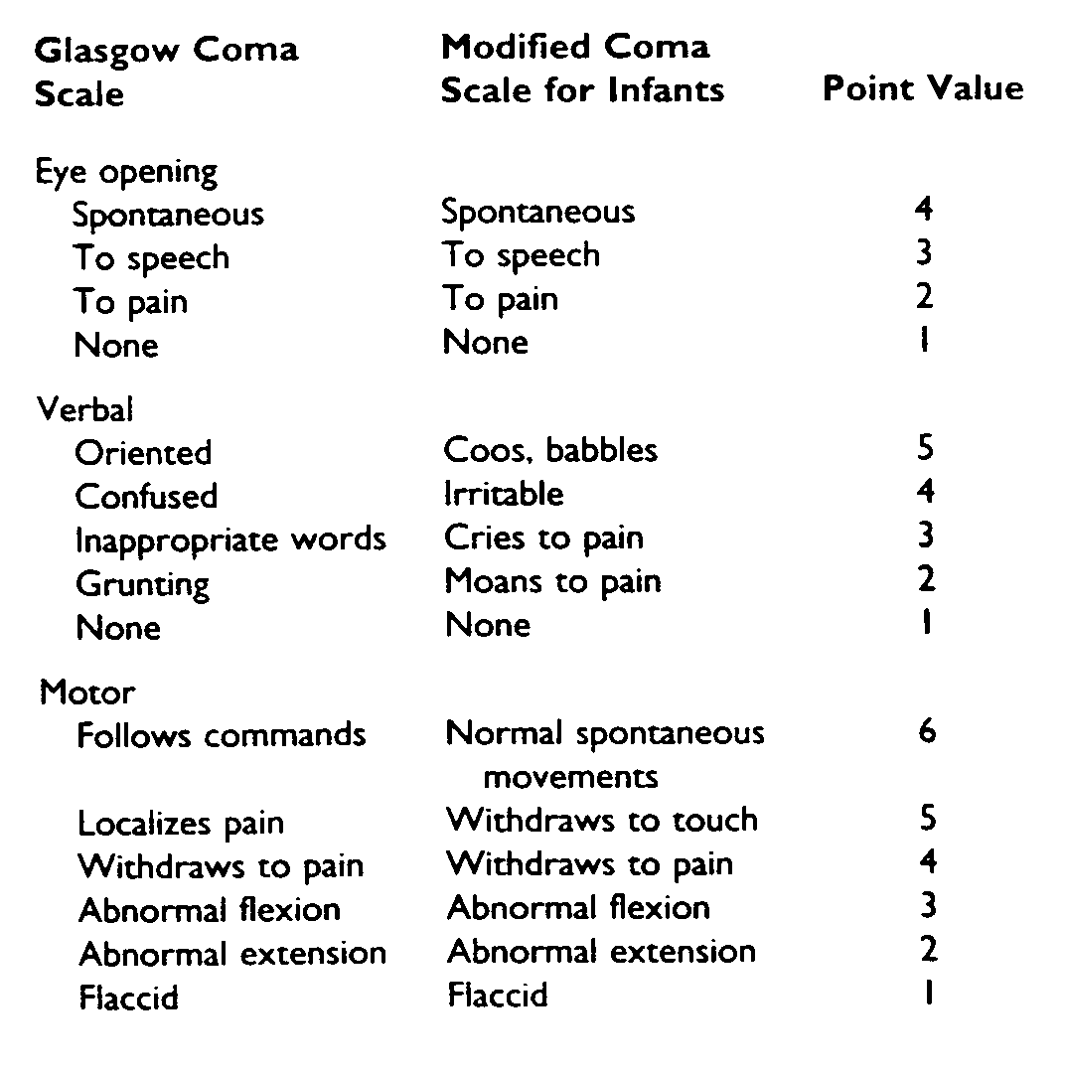
Glascow Coma Scale

Slide 13
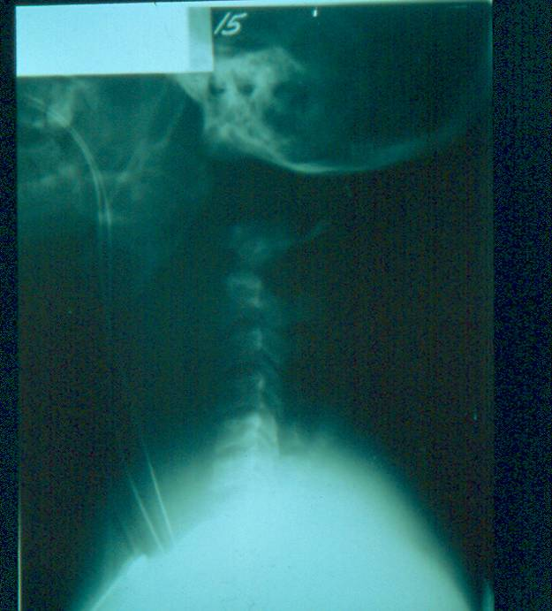
Associated Injuries
50% BTAT
3-5% spine
15-20% ortho
Increase severity

Slide 14
Skull Fractures
5 - 15% of mild head injuries
30 - 70% in child abuse cases
History usually reliable
Often with focal scalp injury
Increases suspicion of brain inv.
Usually require observation

Slide 15
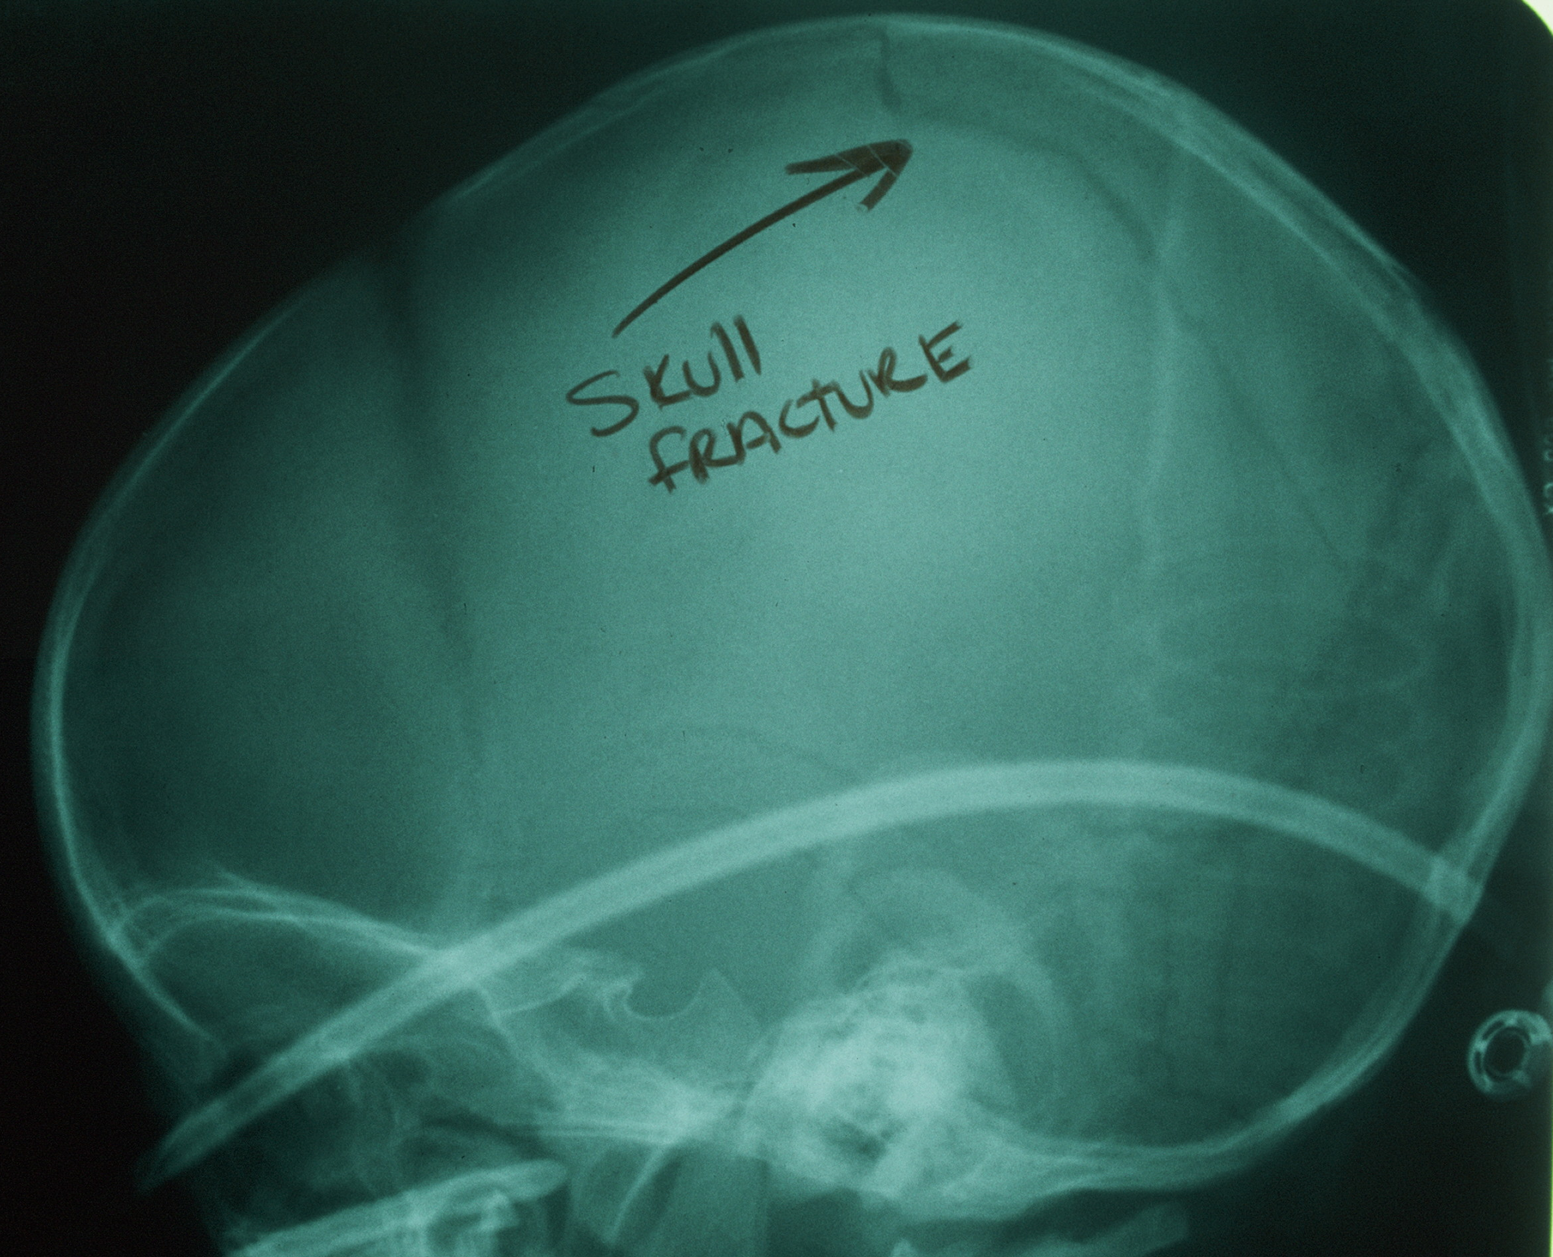
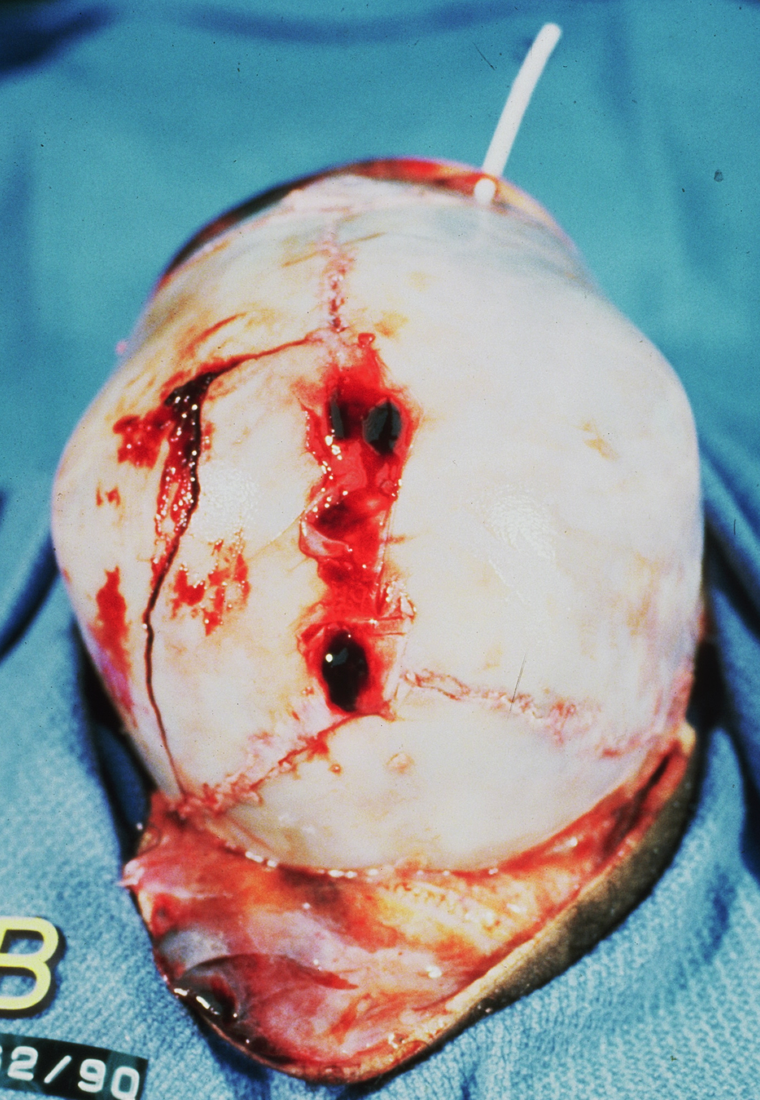
Skull Fractures
…takes much force to fracture a skull!

Slide 16




Epidural Hematoma

Slide 17
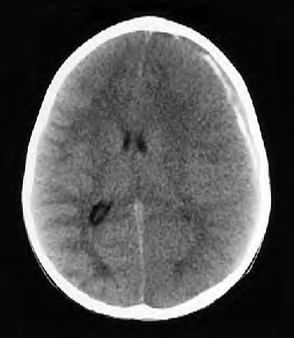
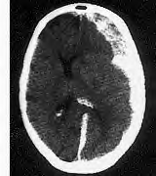


Subdural Hematoma

Slide 18
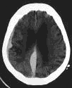
Non-accidental Trauma
Interhemispheric falx hemmorhage
Sub-dural hemorrhage
Large, non-acute extra-axial fluid
collection
Basal ganglia edema
p<0.05 for above per Hymel et al, Pediatr Radiol;
(1997 Sep) v27 n9 p743-7.

Slide 19
Cerebral Concussion
Most frequent head injury
Loss of neurologic function
Temporary paralysis of function
Altered cerebral blood flow
No structural abnormality
Outcome uniformly excellent

Slide 20
Cerebral Concussion
Variable level of consciousness
Loss of tone, reflexes, resp. control
Pupil abn., cortical blindness
Pallor, heart rate abn., vomiting
Lethargy, slurred speech
Confusion, amnesia of events

Slide 21
Admission Criteria
Decreasing consciousness
Persistent confusion / lethargy
Excessive headache / vomiting
Uncertain history of trauma
Focal neurologic signs
Seizures / skull fracture

Slide 22
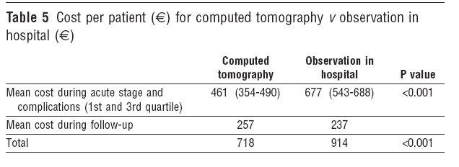
Observation
OCTOPUS – observation or computed tomography of mild head injury in Sweden: a randomized clinical trial concerning effects and costs
Gierjersta JL, et al: BMJ 2006; 465 and 469

Slide 23
Infants - recommendations
High Risk: CT scan
Skull fracture, seizure, bulging fontanel, LOC > 1 min,
decrecased mental status, focal neurologic deficit
Intermediate Risk: CT scan
LOC < 1 min, nonacute skull fx, vomiting, caretaker concern,
High energy mechanism, large scalp hematoma, unwitnessed injury
Low Risk: Observe and Discharge
Low energy mechanism, (fall < 3 ft), asymptomatic,
Over 2 hours from injury, older age (> 12 mo)
Schutzman SA, et al: Pediatrics (2001) 107: 983-993

Slide 24
Post-concussive Syndrome
Persistent headaches
Dizziness / lightheadedness
Difficulty with concentration
Irritability, stress intolerance
Often in intelligent patients
Normal neurologic exam

Slide 25
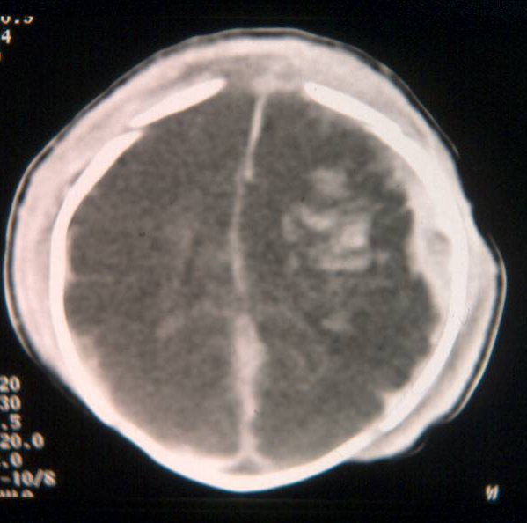
Cerebral Contusion

Slide 26
Seizures
Increase CBF and ICP
Higher incidence with GCS
~20% if cerebral contusion
Immediate seizures not recurrent
? Prophylactic anticonvulsant use
Treat for 2-4 weeks??

Slide 27
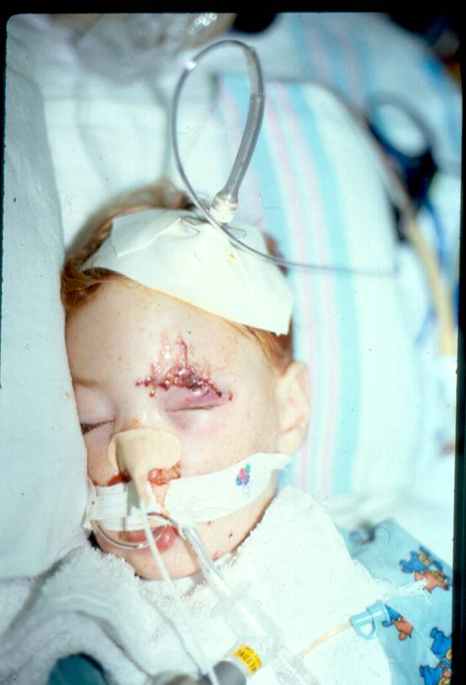
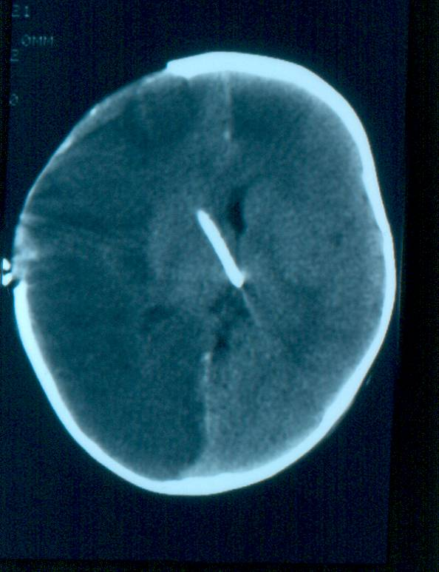
Diffuse Axonal Injury

Slide 28
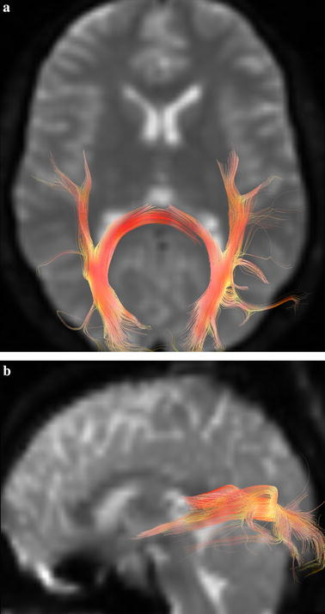
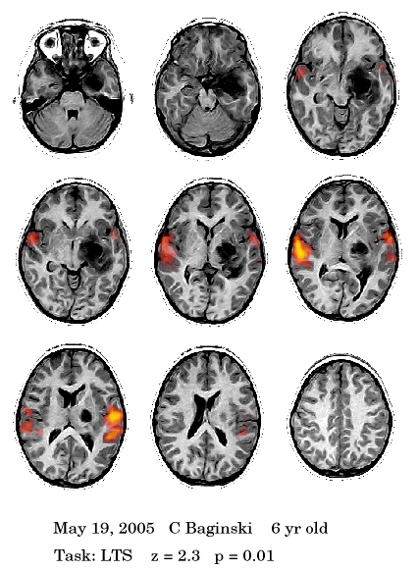
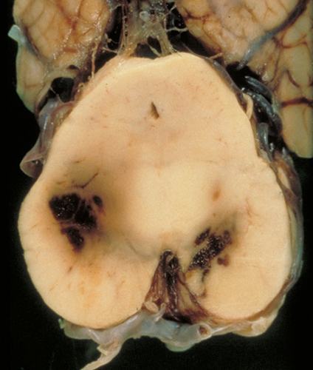
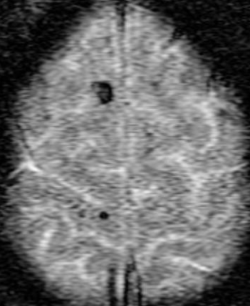
Diffuse Axonal Injury
Some evidence that axons are not initially disrupted only swollen

Slide 29
Diffuse Axonal Injury
Diffuse cerebral swelling in 2-5 X more common in children than in adults, possibly due to ischemia
  Zwienenburg Muizelaar J Neurotrauma 16(10):937-43
In severe head injury, autoregulation is intact 59% of the time, and dysfunctional 41%
  Muizelaar, et al J Neurosurg 71:72-76
If autoregulation is intact, ICP varies inversely with MAP, directly if autoregulation is not intact
  Bouma et al J Neurosurg 77:15-19

Slide 30
Pediatric Head Injury:
Part II - Current management
Jogi V. Pattisapu, MD FAAP FACS
Emeritus Medical Director
Arnold Palmer Medical Center
College of Medicine
University of Central Florida
Orlando FL USA
JogiP@mail.UCF.edu

Slide 31
Hyperventilation
Immediate in CSF pH
1 torr PCO2 CBF by ~ 3%
May try mild hypervent. in kids
Prophylactic use ineffective
Recent data do not support use
Appropriate in severe cases of impending herniation

Slide 32
Head Position
Great controversy!
Modest ICP improvement
Improves jugular return
30 - 45 degrees optimal
Avoid during hypotension
? A-line tranducer position

Slide 33
Osmotic Agents
Immediate in blood viscosity
Improves blood flow
1-3 ml/Kg 3% NaCl
0.25 - 2 gm/kg dose mannitol
Hypertonic saline effective
Primary effect by dehydration
BBB must be intact
Monitor serum osmolality ( ~ 300)

Slide 34
Hypothermia
Initially suggested by Phelps in 1897
Mild hypothermia to 32 - 34⁰
5 - 10% CMRO2 change per ⁰C
Hyperthermia injures BBB
2 randomized trials in adults
No consistent data in children

Slide 35
Hypothermia
Reduces cerebral metabolism (7% / °C heat)
Currently under trial for refractory ICP control
Moderate cooling 32-34 degrees can decrease the severity of increased ICP, but not the average ICP in head injured children without coagulopathy
There was no difference in outcome
  Biswas et al Crit Care Med 2002 30(12):2742-51
CoolKids trial underway
? Inc. mortality w/ rapid rewarming
( Hutchinson, et al, NEJM 2008)

Slide 36
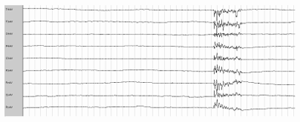
Barbiturate Coma
Cardiovascular depressant (watch your BP!)
Lowers cerebral metabolic rate and ?vasoconstricts
Burst surpression goal on EEG

Slide 37
Barbiturates
No controlled trials in children
Decrease CMRO2
CNS lactate & glutamate
EEG burst suppression or levels
? Survival, but poor outcome
Arterial hypotension common
Recent success in small series

Slide 38
Barbiturates
Suppress brain metabolism, up to 50%
  Piatt, Schiff Neurosurgery 1984 15:427-44
Alters cerebral vascular tone
Associated reduction of coupled CBF, reduces cerebral blood volume and therefore ICP
Bolus iv delivery 10mg/kg, over 30 min
Then 5mg/kg/hr for 3 hours
Hourly delivery 1-5mg/kg
Usually dosed to burst suppression on EEG
May also dose by levels, but not recommended
  Kassell et al Neurosurgery 1980 7:598-603

Slide 39
Barbiturate Coma
Prophylactic use is unsupported
May develop decreased jugular venous saturation of <45%, associated with poor outcome
  Cruz J Neurosurg 1996 85:758-61
Myocardial suppression and hypotension requiring inotropic infusion
  Adelson et al Pediatr Crit Care Med 2003 4(3):S49-52
Role in refractory ICP elevation unclear
  Pittman et al Pediatr Clin N Am 1980 27:715-727

Slide 40
Decompressive Craniectomy
Initially described by Cushing -1905
Some studies suggested edema
Increased use recently (selective)
Better outcomes in young patients
Second tier therapy with barb. coma

Slide 41
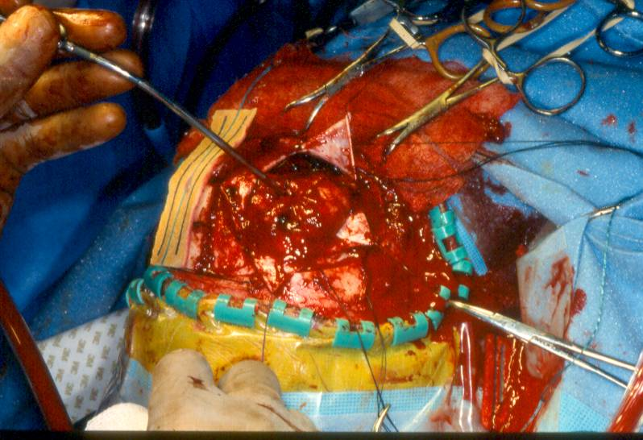
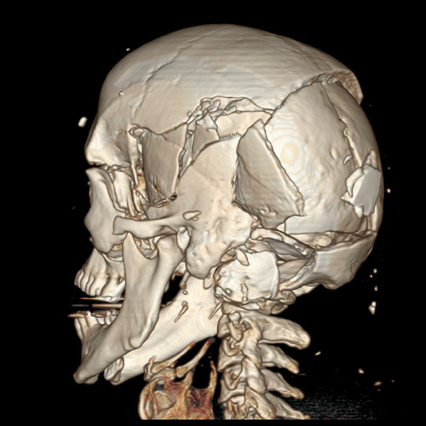
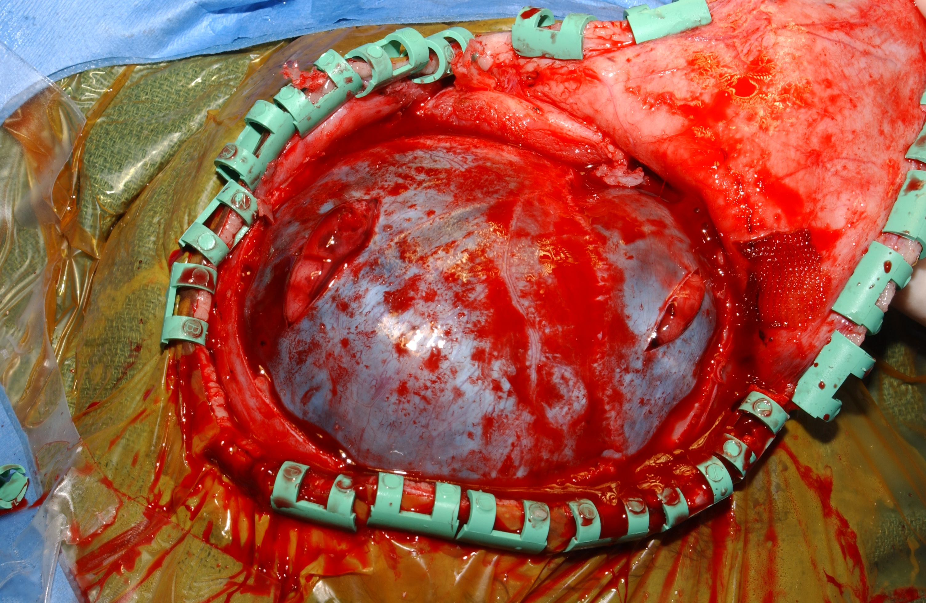
Decompressive Craniectomy
Some recent studies: improved functional outcomes, less mortality
(JNS Jaganathan 2007; Cochrane Database, 2006)

Slide 42
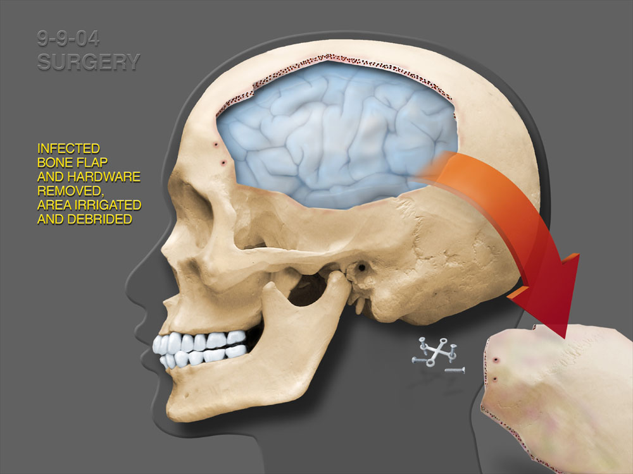
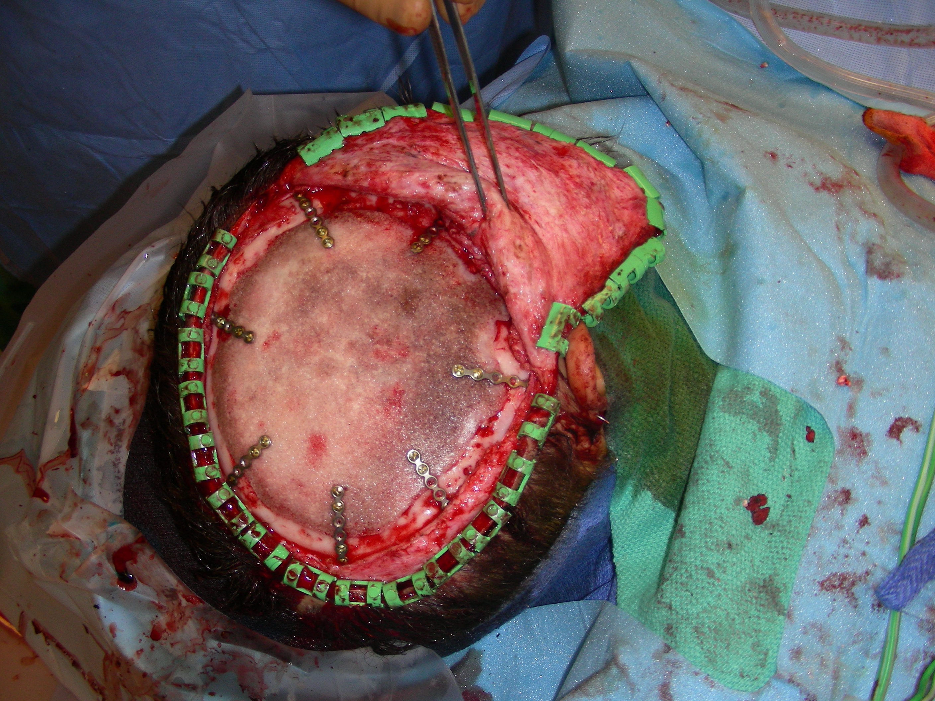
Decompressive Craniectomy
Bifrontal craniectomy was effective in resolving refractory intracranial hypertension in 44% of patient
(Polin et al Neurosurgery 1997 41(1):84-94)
Pilot study showed efficacy in all 6 patients with refractory elevated ICP
  (Ruf et al Crit Care 2003 7(6):R133-8)
Craniectomy, primary or delayed showed positive influence on outcome and survival on pediatric subpopulation (16)
  (Messing-Junger et al Zentralbl Neurochir 2003 64:171-7)

Slide 43
Decompressive Craniectomy
COMPLICATIONS ---
Brain shift form overdrainage
Bone flap storage in children is challenging
  Frozen flap
  Subcutaneous space is small
  Demineralization?
Bone resorption in children could be as high as 50% (Grant, Ellenbogen, et al JNS:Spine 2004)

Slide 44
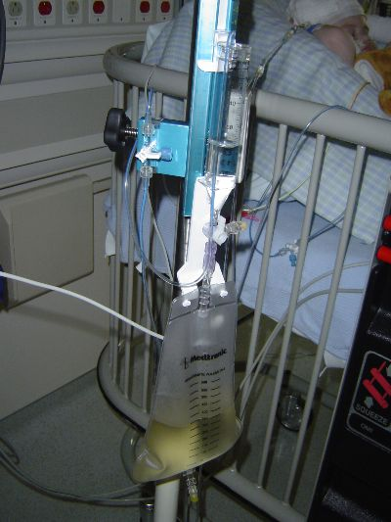
Lumbar Drainage
Controversial technique to treat refractory high ICP when ventriculostomy and medical management is ineffective
  Levy et al J Neurosurg 1995 83(3):453-60
  Munch et al Crit Care Med 2001 29(5)976-81
Can lead to tonsillar herniation
  2 patients, Munch et al Crit Care Med 2001 29(5)976-81
  Baldwin, Rekate Pediatr Neurosurg 1991-2 17(3):115-20

Slide 45
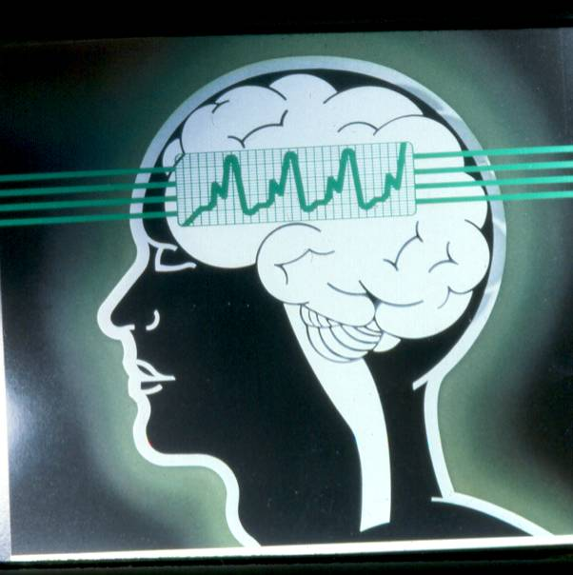
Controversies in Management
Steroids
Hemodilution
Hypoglycemia
Prophylactic anticonvulsants
Controlled arterial hypertension
Liquid ventilation / ECMO

Slide 46
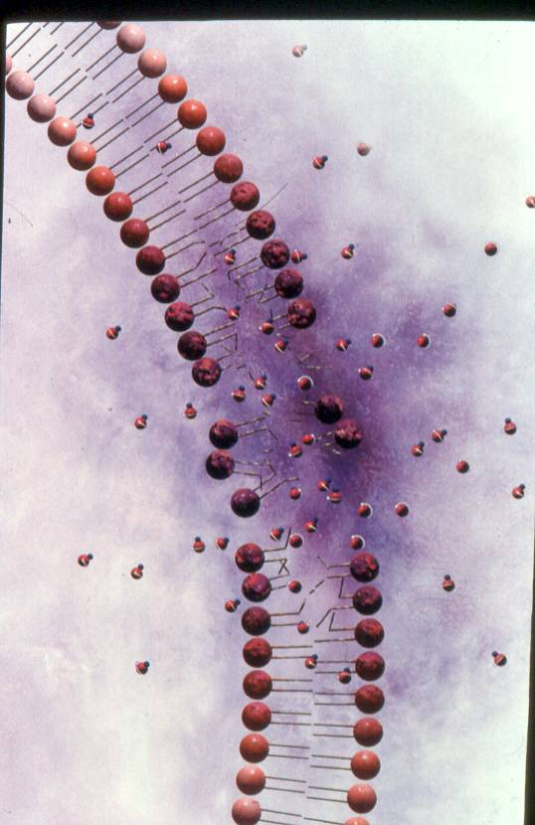
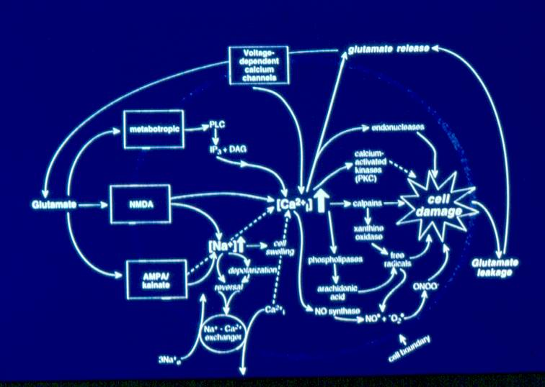
Cell Damage

Slide 47
Prevention
Almost always forgotten!!!
Simple common sense
Use available resources
Child seat enforcement
Occupant Protection Program
ThinkFirst program
Safe Kids programs

Slide 48
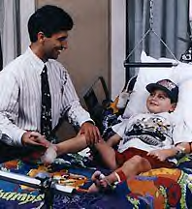
Outcomes
Good = 75%
Moderate = 10%
Severe = 5-10%
Death = 1-5%
Where do we send our HI patients?
Be an eternal, pragmatic optimist!

Slide 49
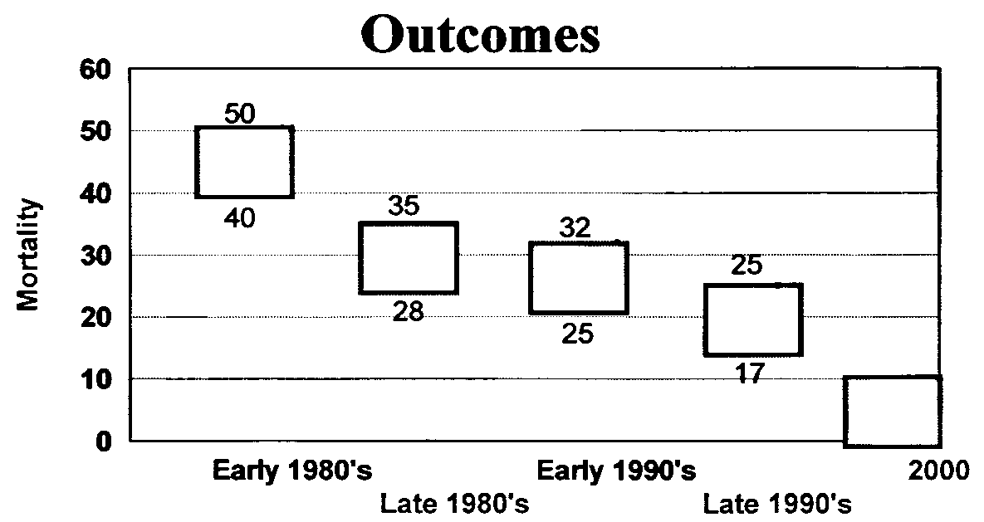
Mortality Rates

Slide 50
Discussion
Marked increase in diagnosis
Some improvement in outcome
Better understanding of pathophysiology and brain injury
Future looks somewhat better
Cautious optimism appropriate

Slide 51
Deterioration
“…patients at greatest risk for inadequate diagnosis and treatment [are] those who are predicted to be at relatively low risk of dying…”
Klauber MR, Marshall LF, Luerssen TG, et al.: Determinants of head injury mortality: Importance of the low risk patient. Neurosurgery 24:31-36, 1989

Slide 52

Discussion
Incidents that lead to injuries may not be intentional - BUT, they are PREVENTABLE

Slide 53
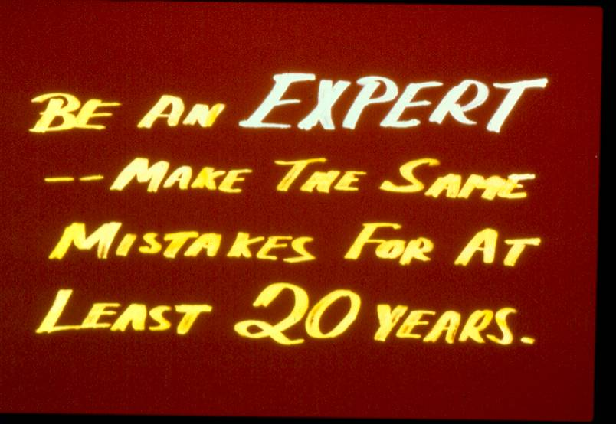
Conclusion

Slide 54
Conclusion
Optimal care of the child with traumatic brain injury requires timely intervention by a highly specialized group of dedicated individuals.

Slide 55
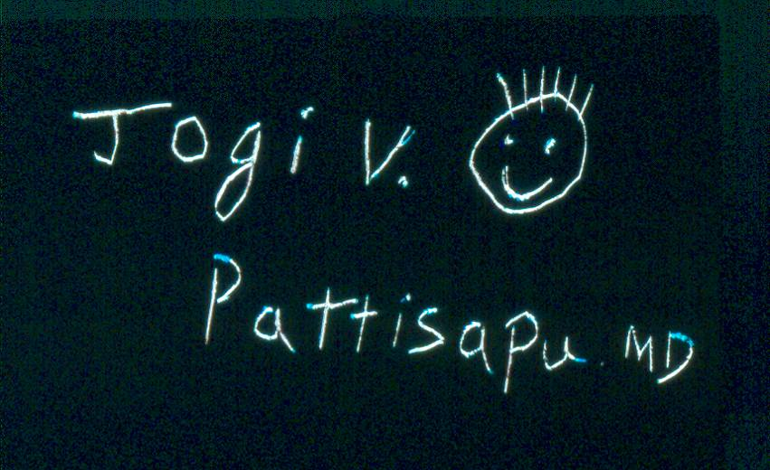
Thank You!
Jogi V. Pattisapu, MD FAAP FACS
Emeritus Medical Director
Arnold Palmer Medical Center
College of Medicine
University of Central Florida
Orlando FL USA
JogiP@mail.UCF.edu

