Slide 1
Foramen Magnum Meningiomas
The Sixth Annual International Neurosurgery Conference
21-28 August 2010
Ajler Pablo
Vecchi E,Knezevich F., Landriel F.,Hem S., Carrizo A.
pablo.ajler@hospitalitaliano.org.ar
www.hospitalitaliano.org.ar

Slide 2
ForamenMagnum(FM) Meningiomas
History
First case of a FM meningioma was an autopsy finding by Hallopeau in 1872
First successful removal was accomplished by Elsberg and Strauss in 1927

Slide 3
Foramen Magnum Meningiomas
Most commonly observed FM tumors
14-19% of intracranial tumors
1.5 to 3.2% arises at the foramen magnum
Ten percent have an extradural extension

Slide 4
Foramen Magnum Meningiomas
Lesion is often large when discovered
Slow-growing rate
Indolent development
Wide subarachnoid space at this level
Prerequisite for treating FM meningiomas is the perfect knowledge of the surgical anatomy

Slide 5
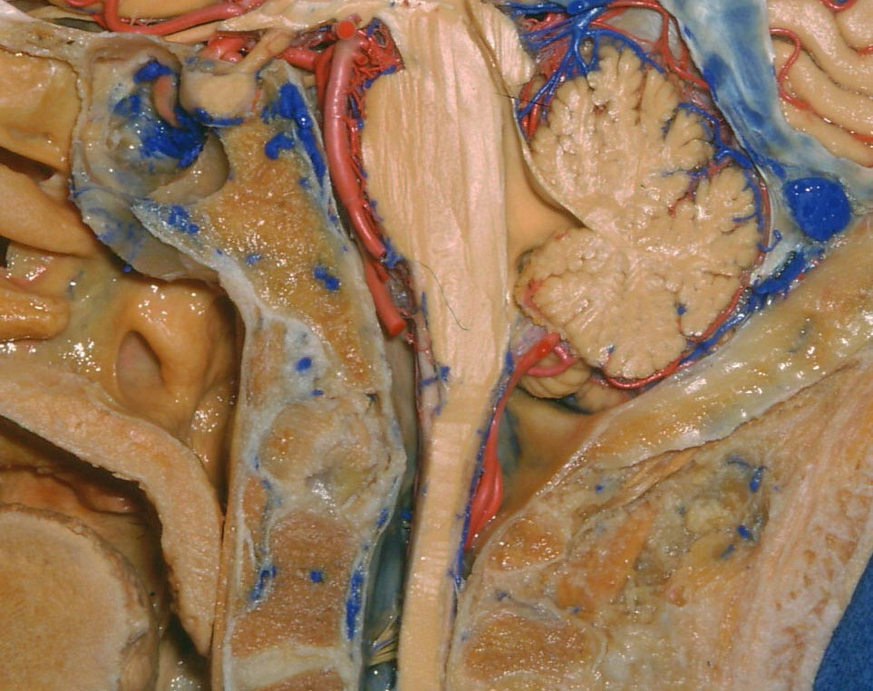
Limits of the FM
Anterior border: lower third of the clivus and upper edge of the body of C2
Lateral borders: jugular tubercles and upper aspect of C2 laminas
Posterior border: anterior edge of the squamous occipital bone and C2 spinous process
Courtesy Dr. Alvaro Campero

Slide 6
Foramen Magnum Meningiomas
Osseous relationships
Vascular anatomy
Lower Cranial Nerves

Slide 7
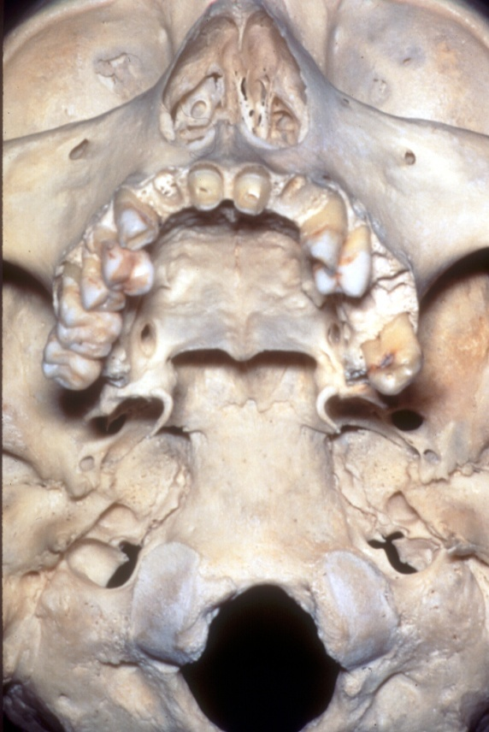
Jugular foramen
Hypoglosal canal
Carotid canal
Condyle

Slide 8
Vascular Anatomy
V4
V3
Courtesy Dr. Alvaro Campero

Slide 9
Lower Cranial Nerves
Glossopharingeal
Vagus
Accesory
Hypoglossal
Courtesy Dr. Alvaro Campero

Slide 10
Foramen Magnum Meningiomas
Surgical Approach Planning
Magnetic Resonance Imaging (MRI)
Computed Tomography (CT)
Angiography

Slide 11
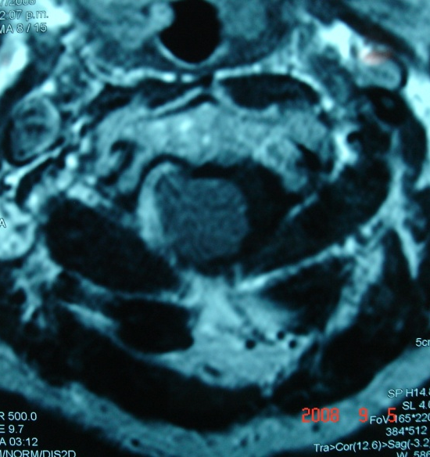
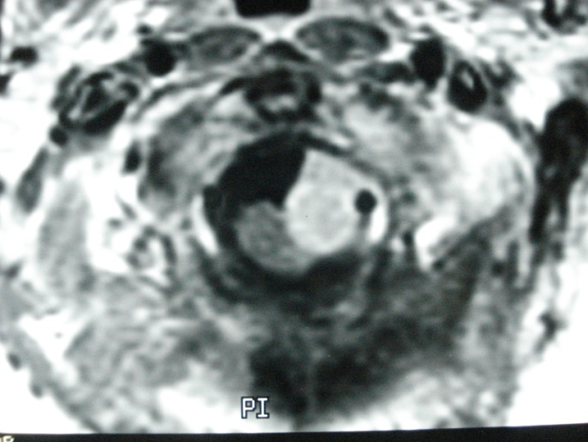
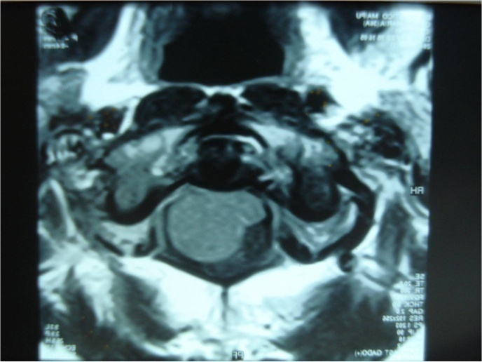
Foramen Magnum Meningiomas
Surgical Approach Planning
-Tumor Location-
Intradural / extradural / intra-extradural
Anterior / lateral/ posterior

Slide 12
Surgical Approach
Far lateral or postero-lateral suboccipital (trans-condylar or retrocondilar)
Midline Posterior

Slide 13
Surgical Aspects
Sitting Position
Head in neutral position (flexion worsen the compression)
Somatosensory evoked potentials
Brainstem Auditory evoked potentials

Slide 14
Foramen Magnum Meningiomas
Eigth (8) F.M. Meningiomas(2000-2010)
Approach
5 Far lateral
3 Midline Posterior
Resection
100% GTR (gross total removal )
No mortality
Inmediate Morbidity: 28.7% (2 patients)
Long term morbidity: 14.28%(1 patient)

Slide 15
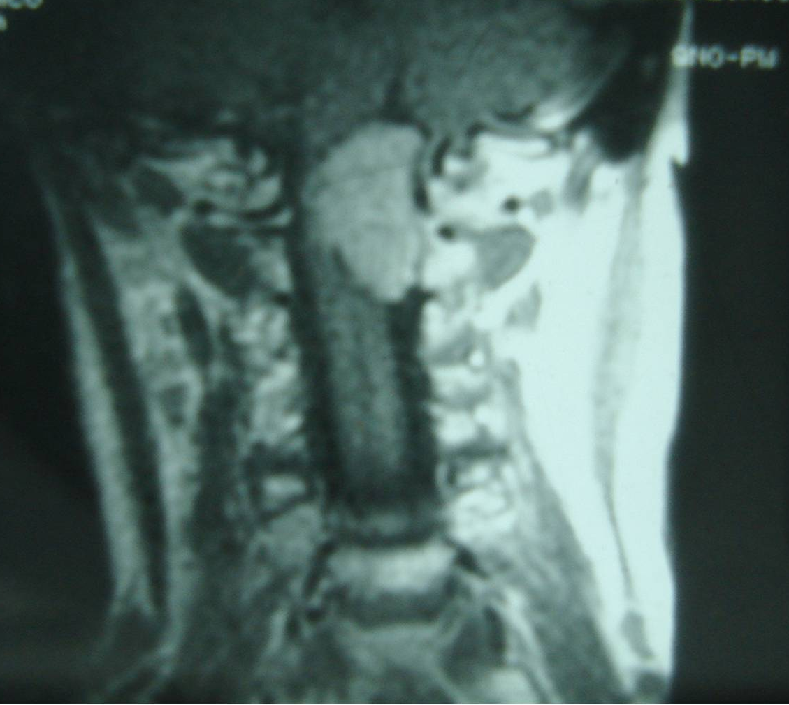
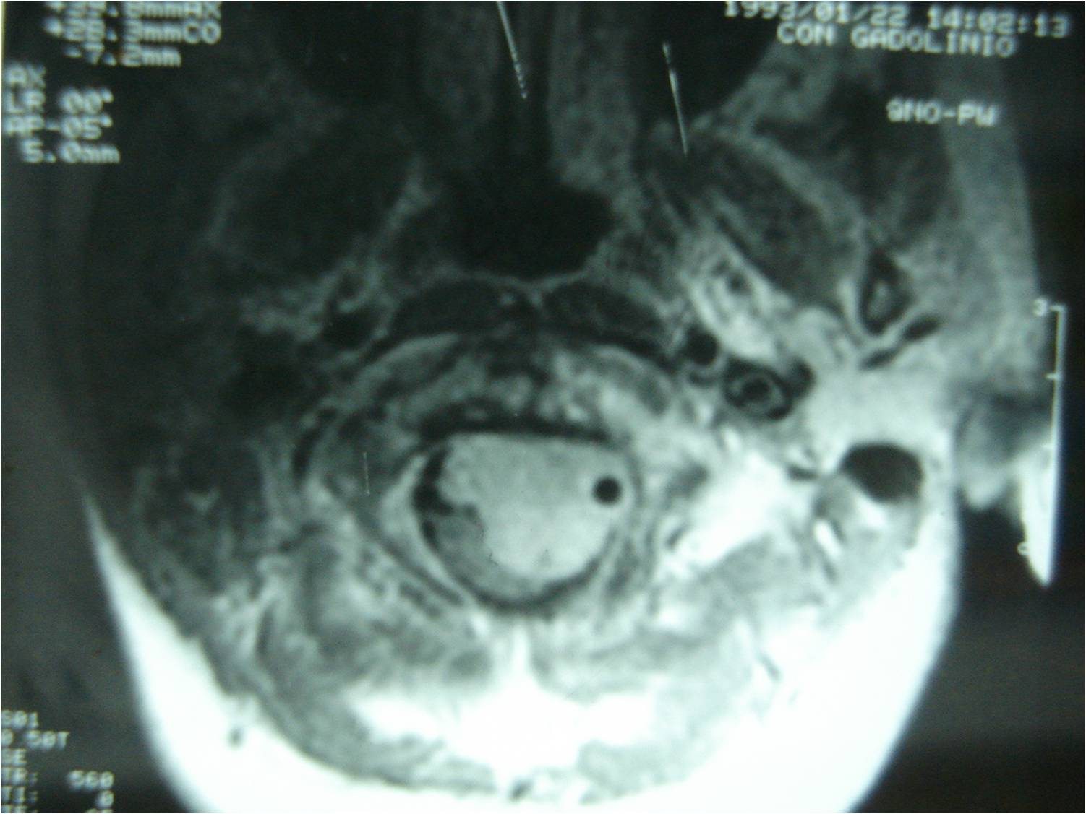
43 y.o. female
Cervico-occipital pain
Paresthesia upper limbs

Slide 16
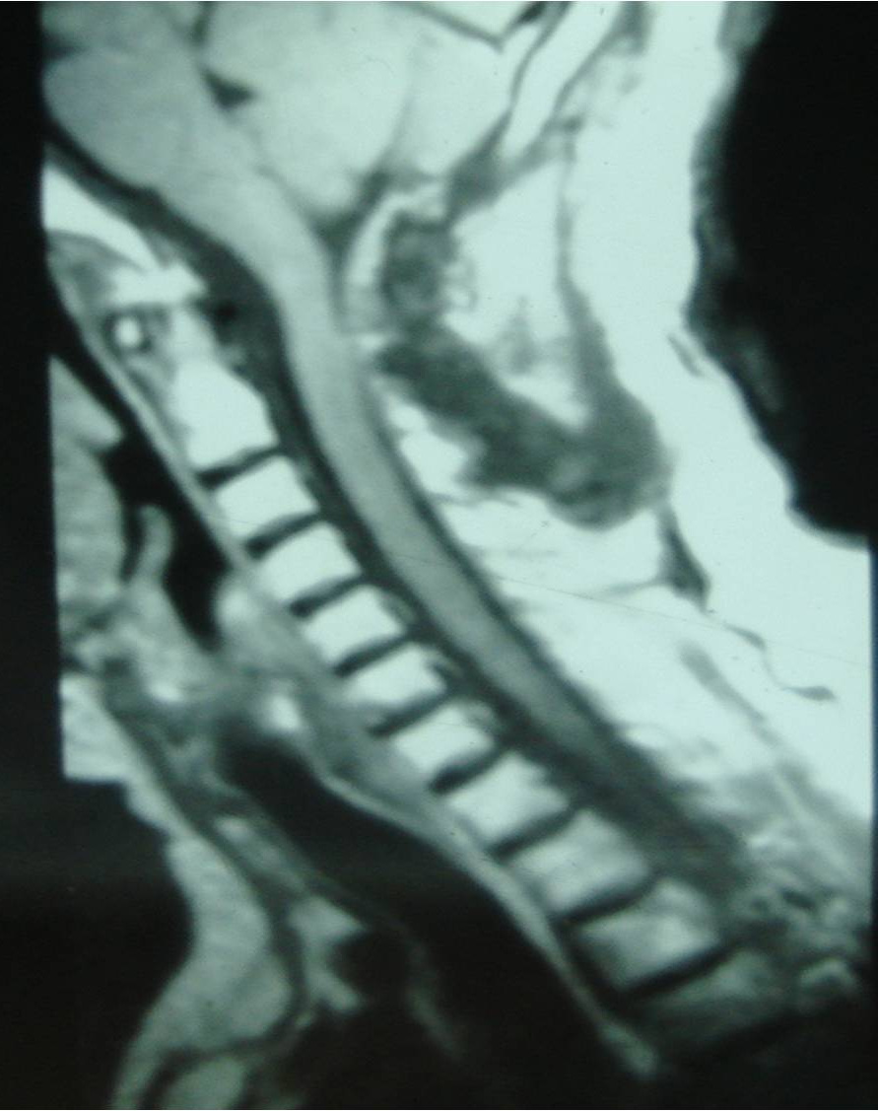
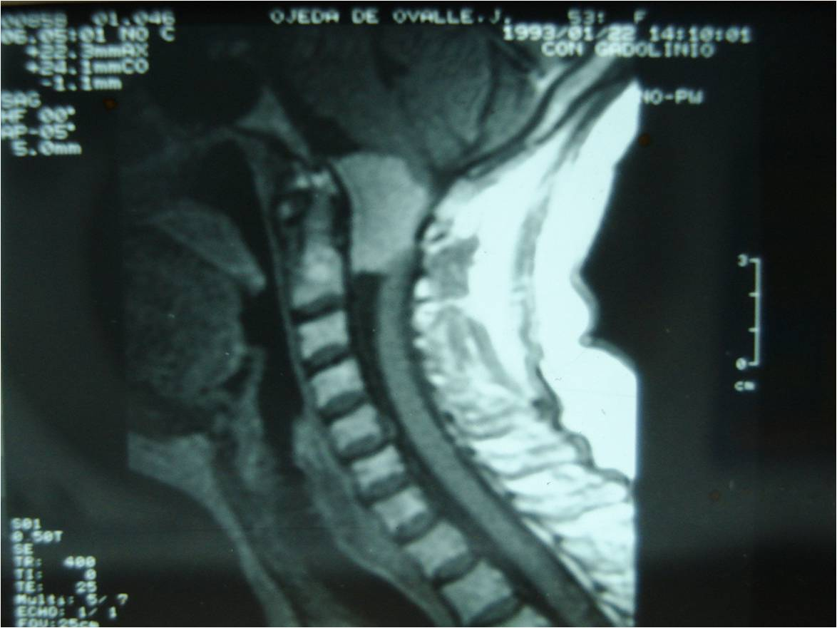

Slide 17
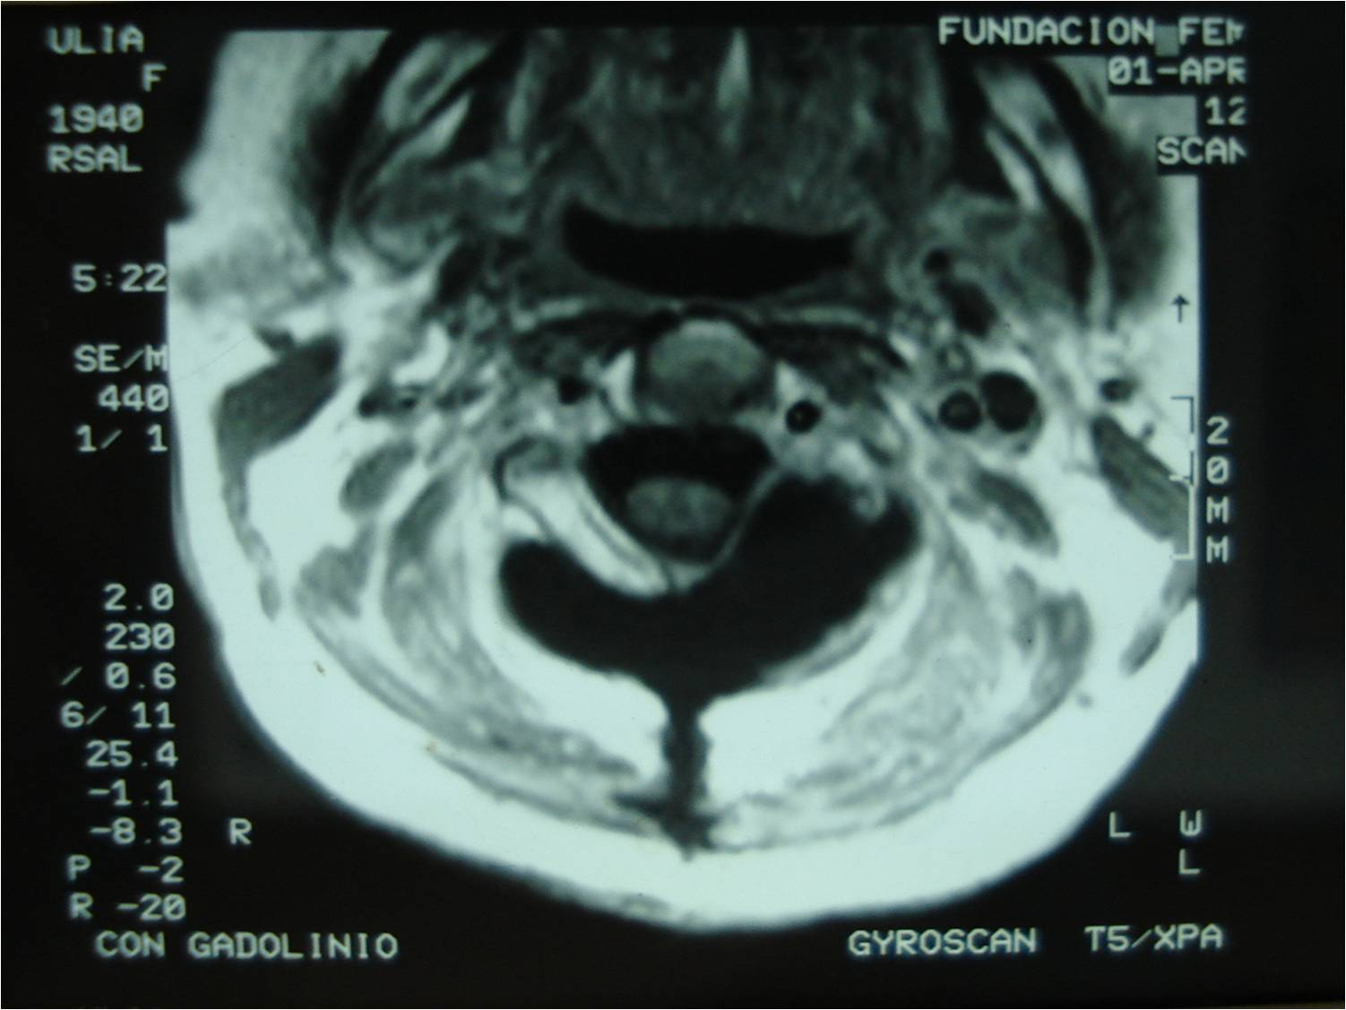

Slide 18
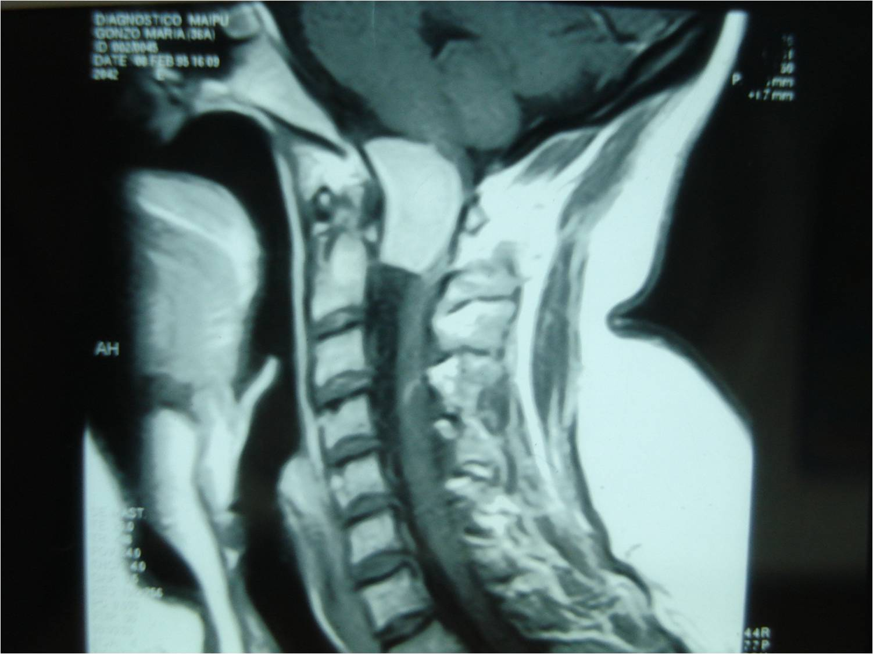
36 yo female
Cervico occipital pain
Gait ataxia

Slide 19
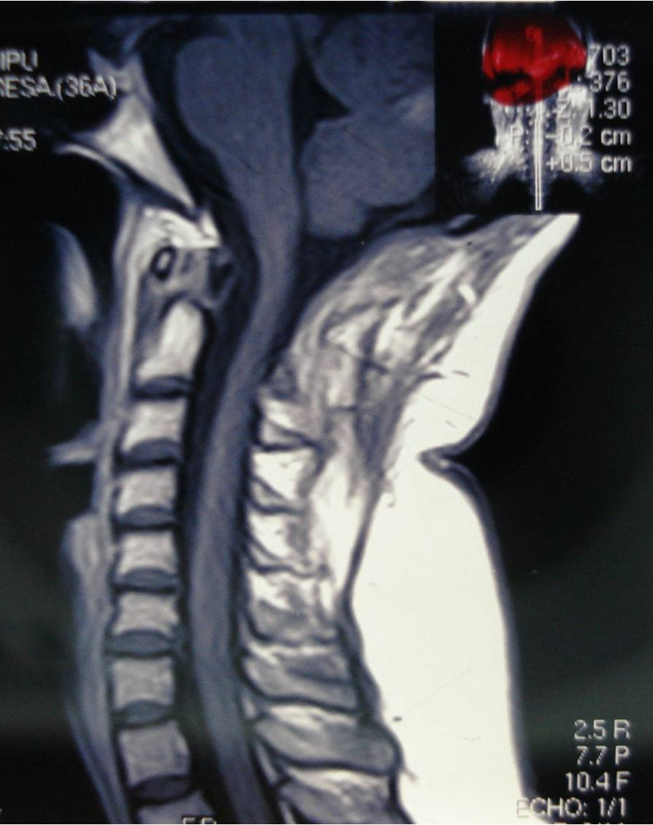

Slide 20
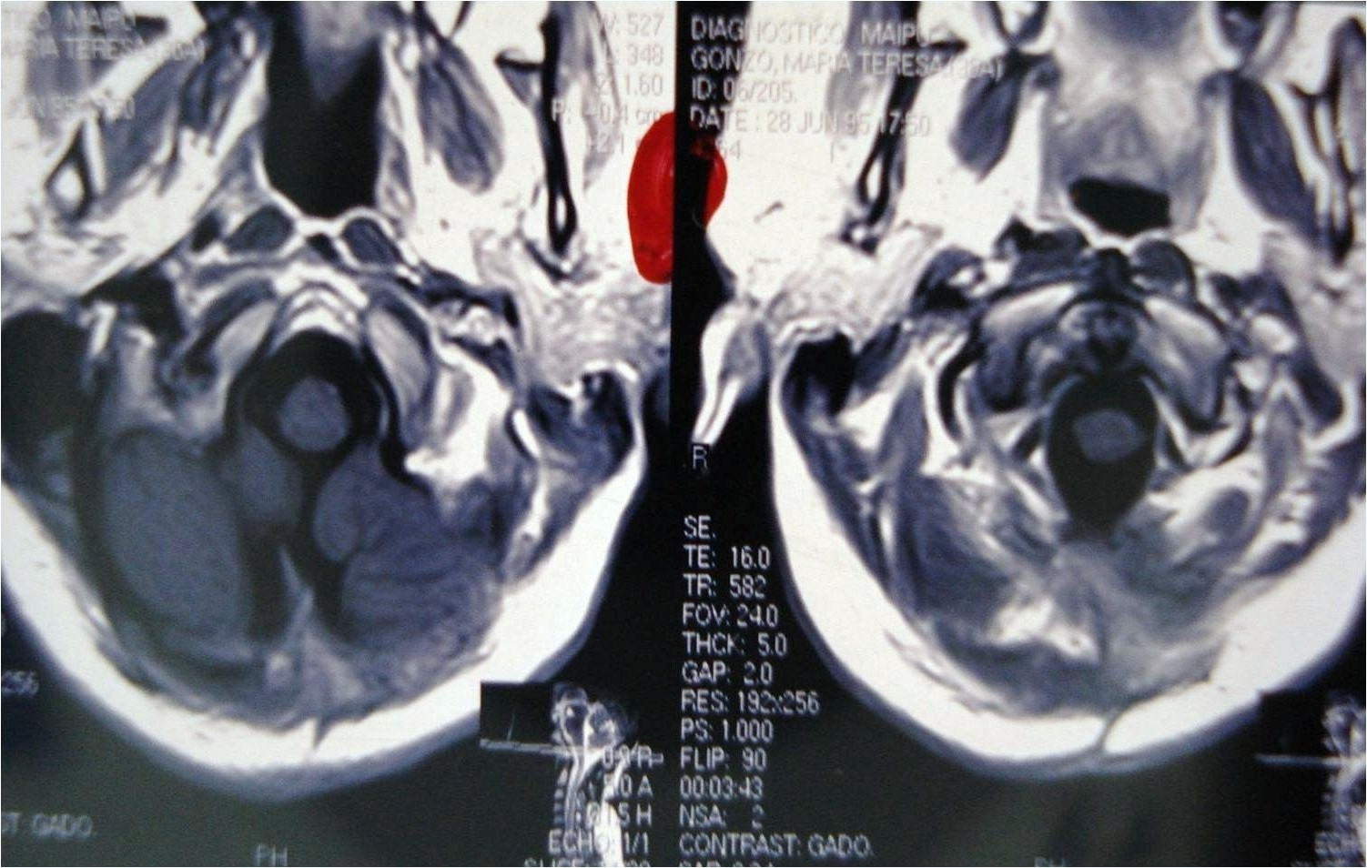

Slide 21
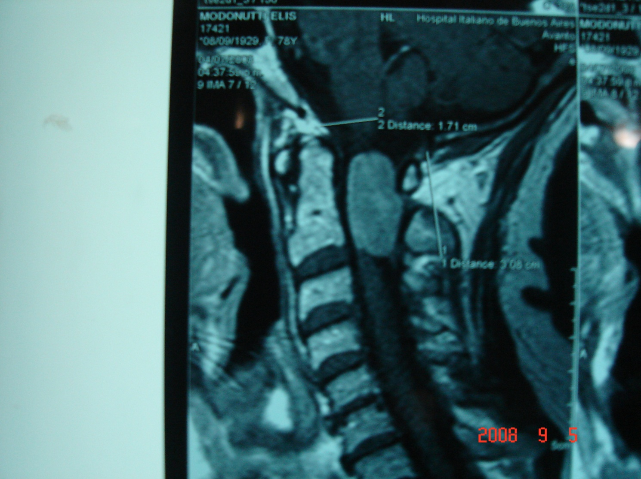
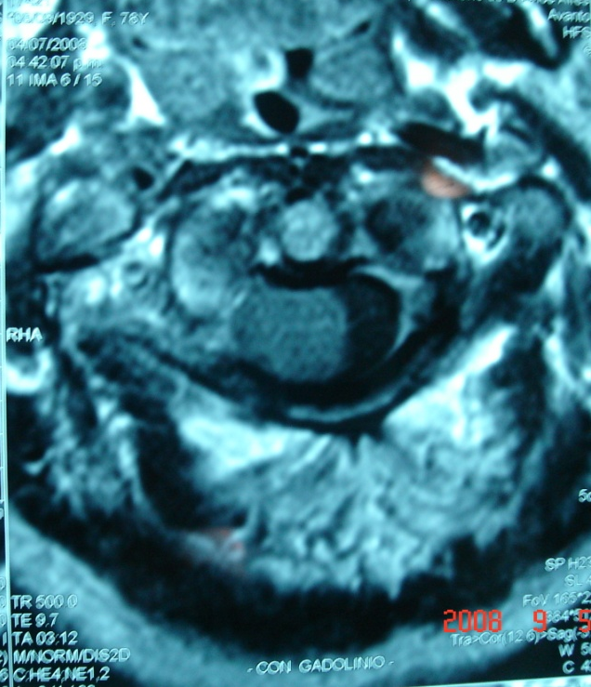
78 yo female
Cervico occipital pain
progressive quadriparesis

Slide 22
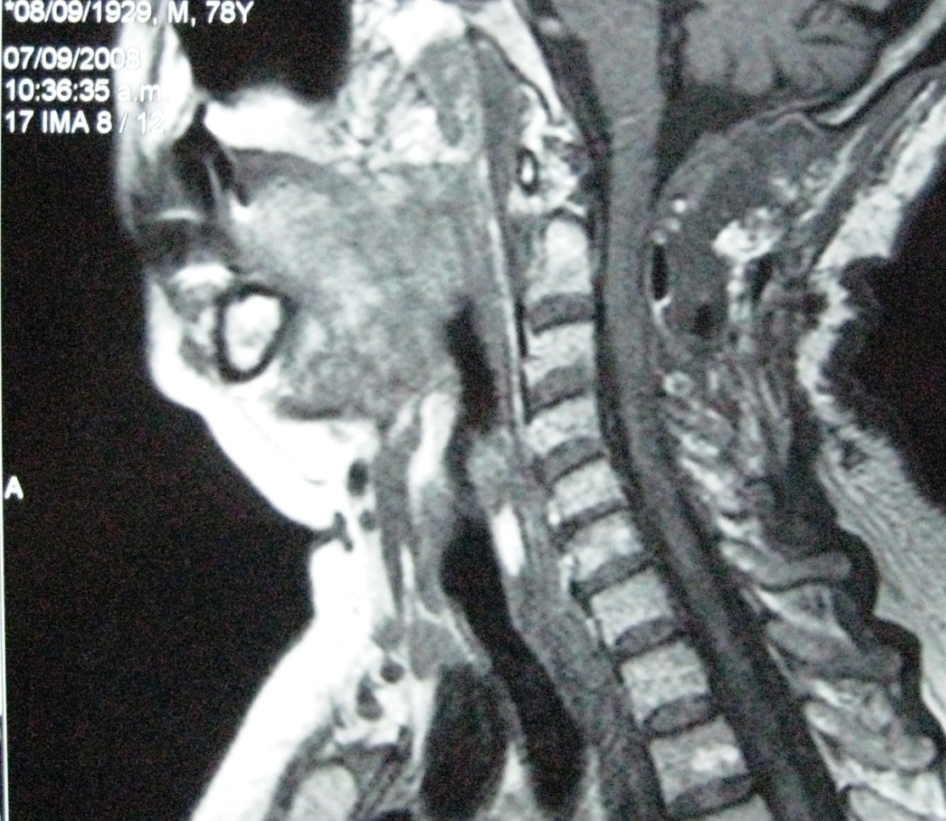

Slide 23
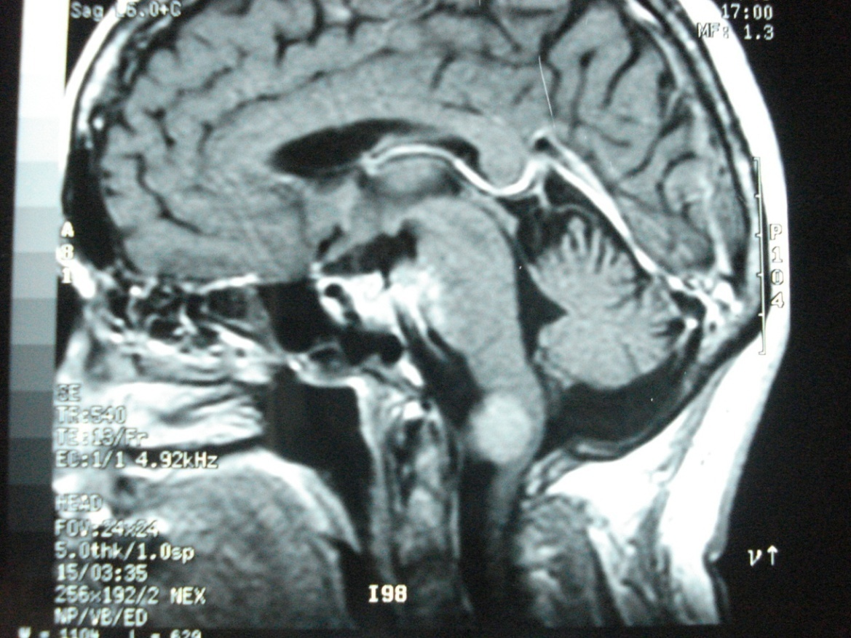
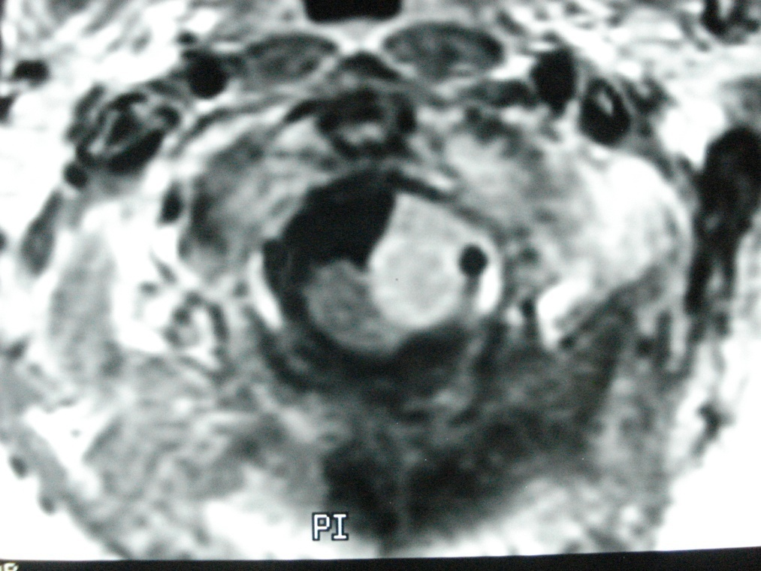
66 yo female
Cervico occipital pain
progressive quadriparesis
Gait ataxia

Slide 24
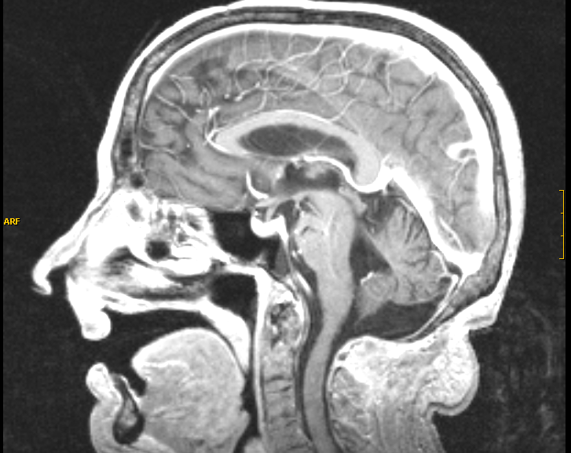
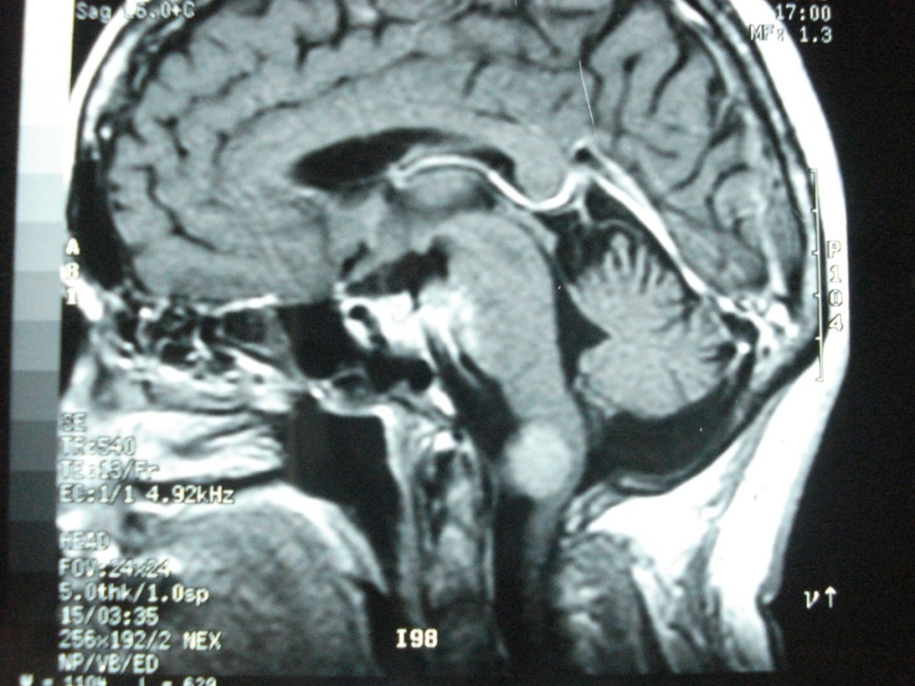

Slide 25
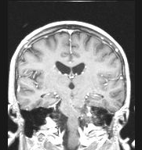
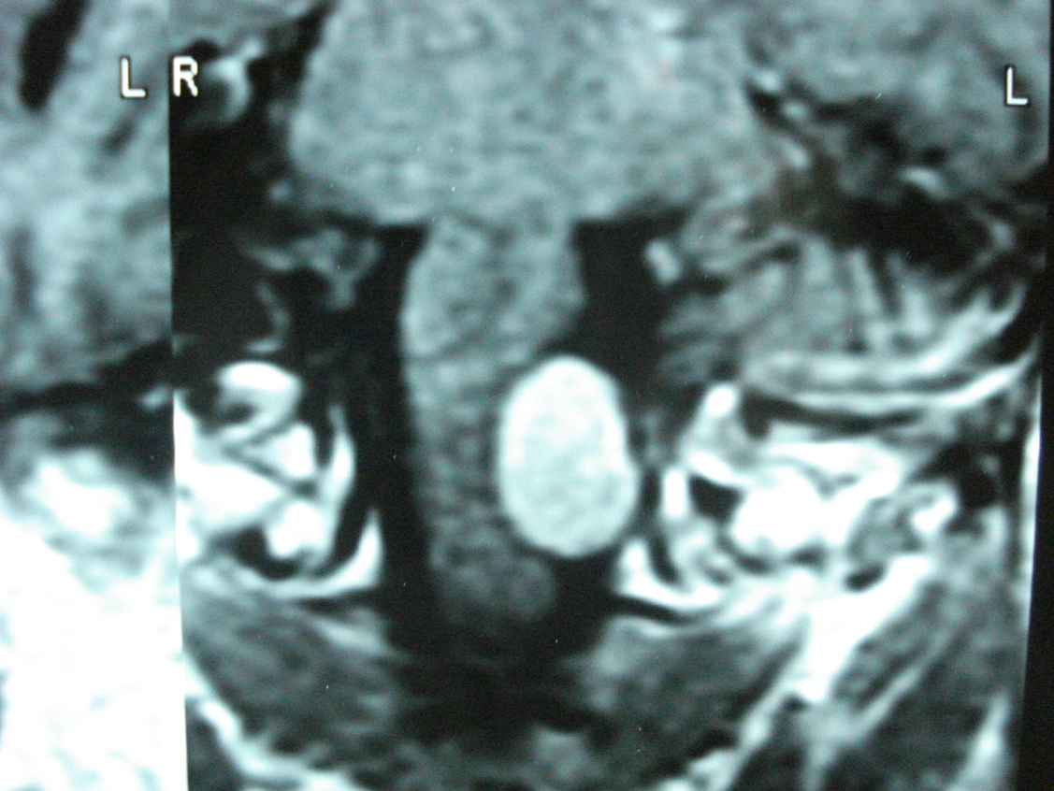

Slide 26
Foramen Magnum Tumors
Tumors of the foramen magnum present a formidable surgical challenge
Several surgical approaches are possible
Big anterior and anterolateral FM meningiomas that displace the medulla/spinal cord can be safely and completely resected via a posterolateral suboccipital retrocondylar approach.

Slide 27
Foramen Magnum Meningiomas
Resection of the occipital condyle should be tailored to individual cases
Small anterior or intra extradural tumors could be operated by an extreme lateral approach
Postoperative complications can be dramatic and must be anticipated

